Slide 1
GRN Prediction Presentation

Slide 2
Overview
Motivation and problem definition
GRN edge prediction methods
Data preparation
Full-dataset evaluation
Statistical evaluation

Slide 3

Motivation
Understanding Gene Regulatory Network is important
Medical
Agricultural

Slide 4
Problem Definition
Goal : Inferring Regulatory Netwok from Expression Data
B
A
C

Slide 5











Problem Definition
Formally, the notations are as follows:
$$Learning Sample=\left\{X_{1}, X_{2}, …, X_{N}\right\}$$
${where X}_{k} ε ℝ^{p}, k=1, …, N$
$$and X_{k}={\left(X_{k}^{1},X_{k}^{2}, …, X_{k}^{p}\right)}^{T}$$
$$N is total number of experiments$$
$$p is total number of genes$$
$$Indexed using “k”$$
Experiments
$$X_{1}$$
$$X_{2}$$
$$X_{3}$$
$$X_{4}$$
$$X_{5}$$
$$X_{6}$$
$$X_{N}$$
1
$$X_{1}^{1}$$
2
3
4
5
6
7
8
$$Indexed using “i” or “j”$$
9
10
p

Slide 6




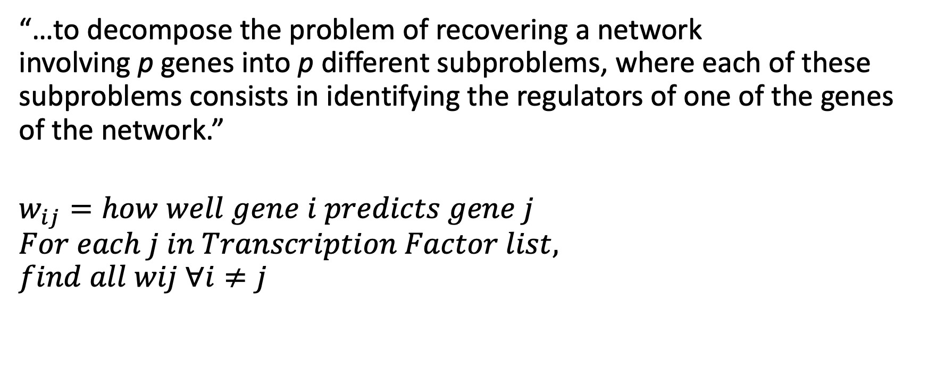






Problem Definition
“…to decompose the problem of recovering a network involving p genes into p different subproblems, where each of these subproblems consists in identifying the regulators of one of the genes of the network.”
$$w_{ij}=how well gene i predicts gene j$$
$$For each j in Transcription Factor list,$$
$$find all wij ∀i≠j$$
Experiments
$$Indexed using “k”$$
$$X_{1}$$
$$X_{2}$$
$$X_{3}$$
$$X_{4}$$
$$X_{5}$$
$$X_{6}$$
$$X_{N}$$
1
$$X_{1}^{1}$$
2
3
4
5
6
7
8
9
$$Indexed using “i” or “j”$$
10
p

Slide 7











Problem Definition
$$Indexed using “k”$$
So for each target gene j:
$X_{k}^{j}=f_{j}\left(X_{k}^{−j}\right)+ε_{k}, ∀_{k}$
Where:
$$X_{k}^{−j}={\left(X_{k}^{1}, …, X_{k}^{j−1}, X_{k}^{j+1}, …, X_{k}^{p}\right)}^{T}$$
Experiments
$$X_{1}$$
$$X_{2}$$
$$X_{3}$$
$$X_{4}$$
$$X_{5}$$
$$X_{6}$$
$$X_{N}$$
1
$$X_{1}^{1}$$
2
3
4
5
6
7
8
$$Indexed using “i” or “j”$$
9
10
p
$$Idea: Some predictor genes in X_{k}^{−j} is better than other, this becomes a feature selection problem.$$
$$The better predictors are considered the regulators of target gene j$$

Slide 8
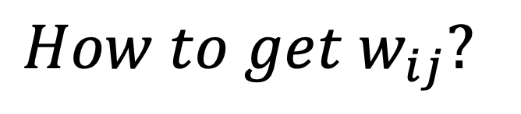

Problem Definition
$${Importance of predictor gene i for target gene j\text{: }w}_{ij}$$
$$How to get w_{ij}?$$
Regression Forest (GENIE3)
LASSO Regression
Support Vector Regression

Slide 9

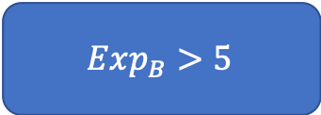
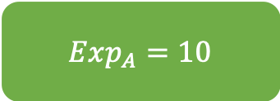


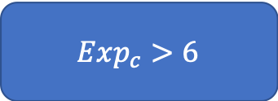
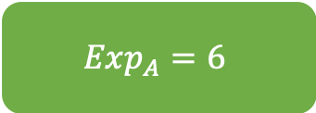
GRN edge prediction methods: Reg. Forest
$$For each j, find all w_{ij} ∀i≠j$$
B
Regression trees use variance reduction instead of an “impurity” metric
$Exp_{B}>5$
A
C
yes
no
$$Exp_{A}=6$$
$Exp_{c}>6$
yes
no
$$Exp_{A}=8$$
$Exp_{A}=10$
$$How good is a node?$$

Slide 10


Regression Tree
B
$$For each j, find all w_{ij} ∀i≠j$$
Regression trees use variance reduction instead of an “impurity” metric
A
C
$Exp_{B}>5$
yes
no
$$Exp_{A}=6$$
$Exp_{c}>6$
$$How good is a node?$$
yes
no
$$Exp_{A}=8$$
$Exp_{A}=10$

Slide 11

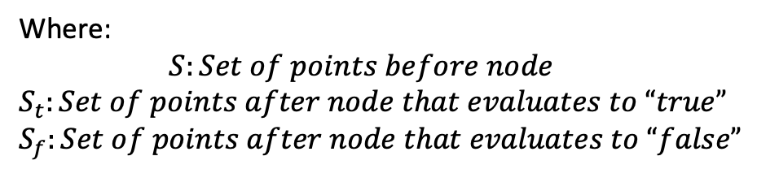

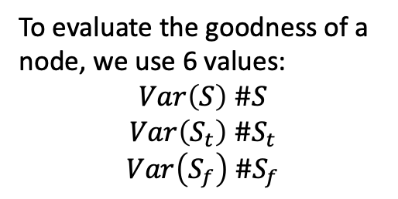



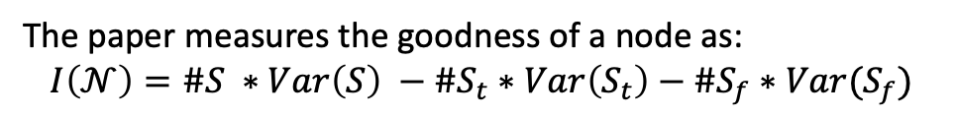
Regression Tree
$Exp_{B}>5$
yes
no
$$Exp_{A}=6$$
$Exp_{c}>6$
yes
no
Threshold
$$Exp_{A}=8$$
$Exp_{A}=10$
To evaluate the goodness of a node, we use 6 values:
$Var\left(S\right) \#S$
$$Var\left(S_{t}\right) \#S_{t}$$
$$Var\left(S_{f}\right) \#S_{f}$$
Expression Level Gene A (j, target)
Where:
$$S:Set of points before node$$
$$S_{t}:Set of points after node that evaluates to “true”$$
$$S_{f}:Set of points after node that evaluates to “false”$$
Expression Level Gene B (i, predictor)
The paper measures the goodness of a node as:
$$I\left(𝒩\right)=\#S ∗Var\left(S\right) −\#S_{t}∗Var\left(S_{t}\right)−\#S_{f}∗Var(S_{f})$$

